Slide 1
Github, R Tricks, Visual Studio Coding
Aight y’all, time to UP YOUR GAME

Slide 2
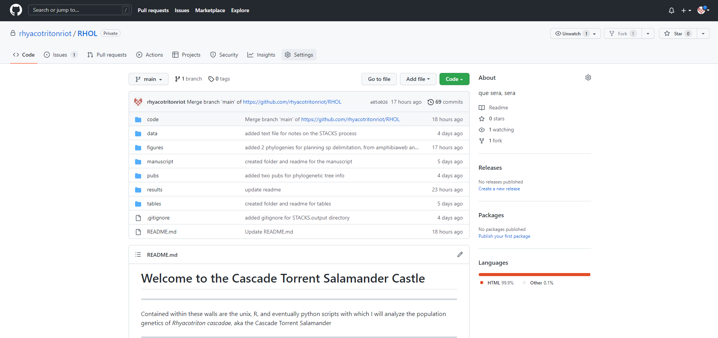
Github

Slide 3
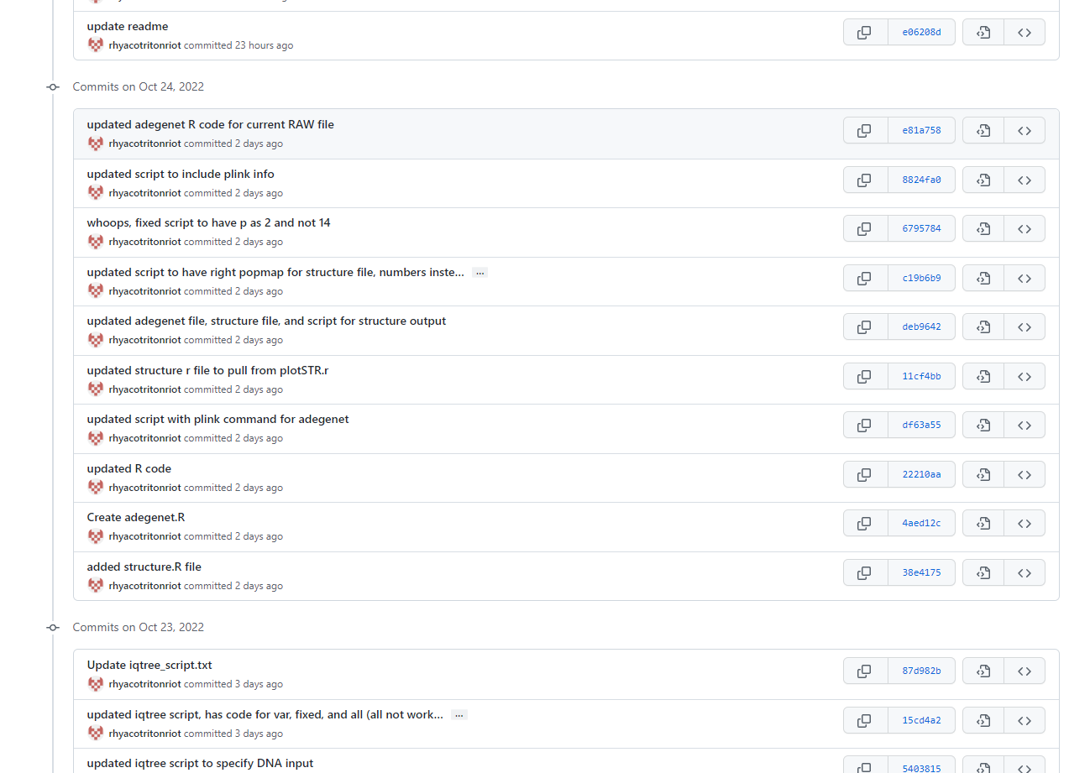
Github – Version Control

Slide 4
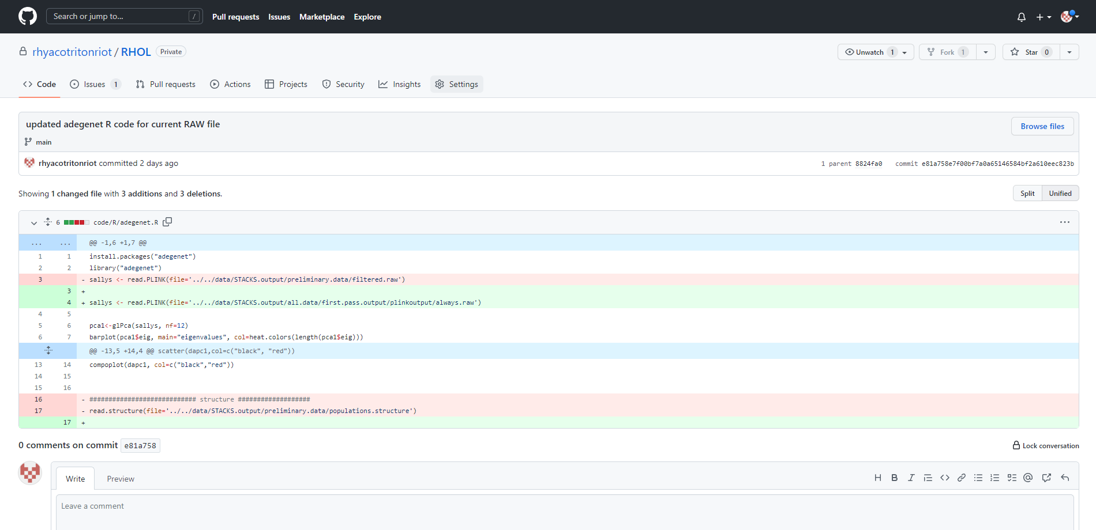
Github – Version Control

Slide 5
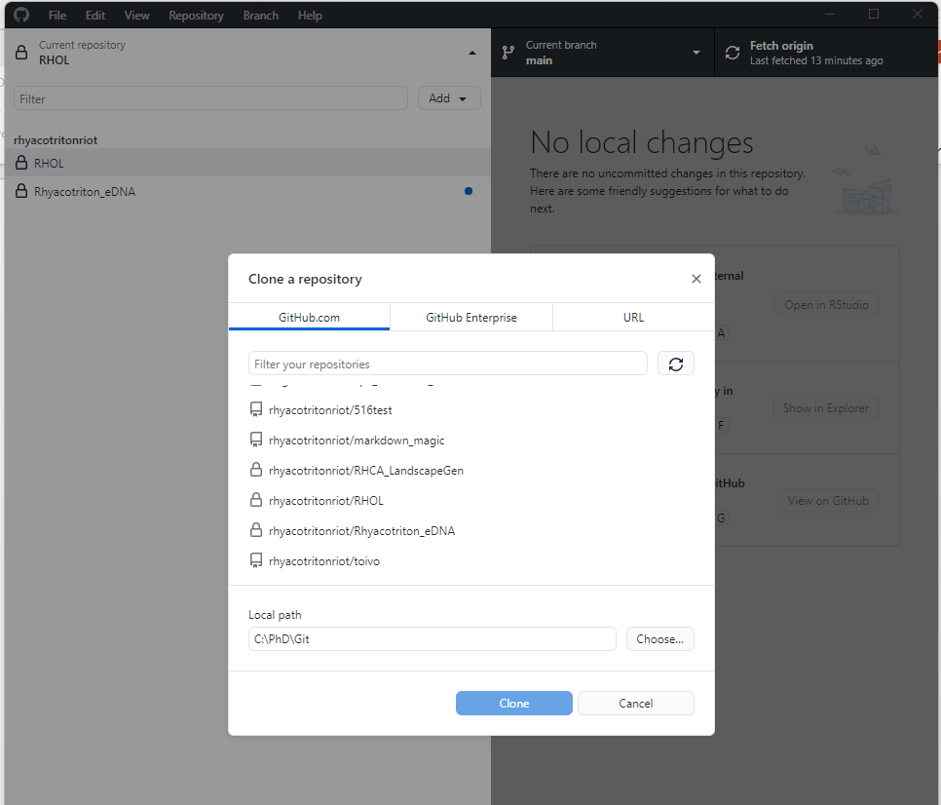
Github – Cloning Repositories

Slide 6
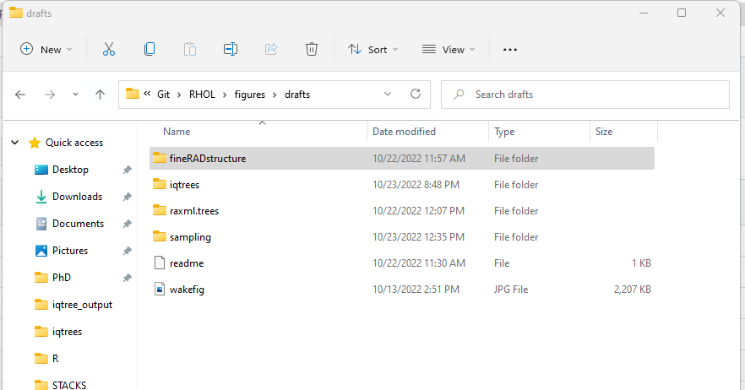
Github – Cloning Repositories

Slide 7
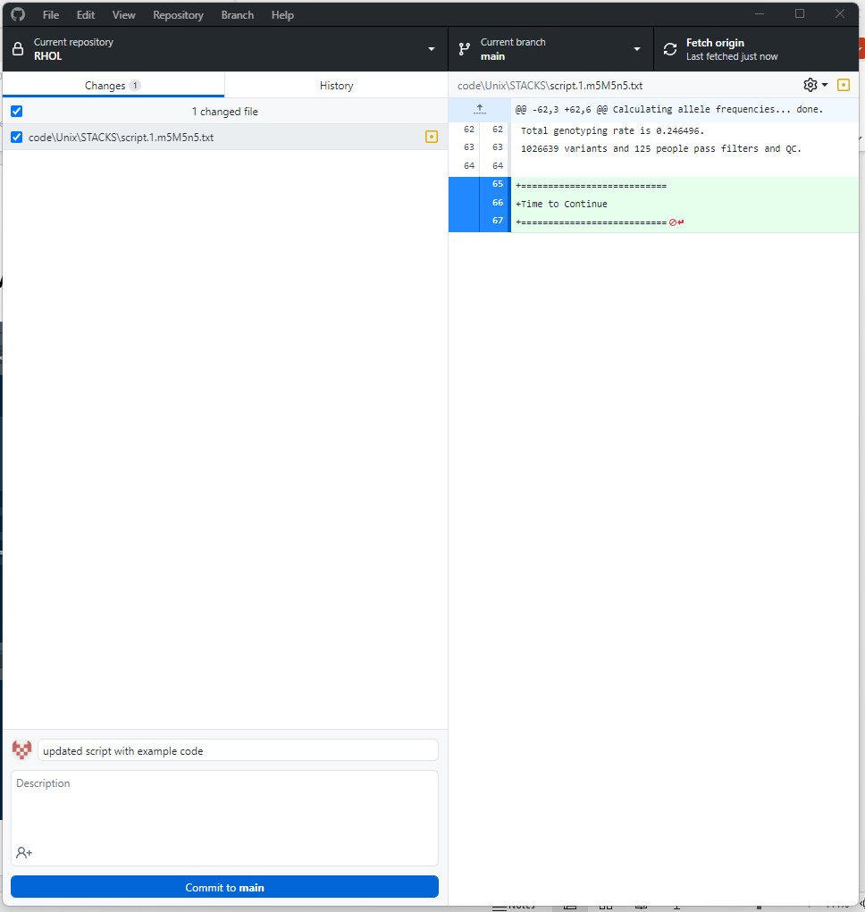
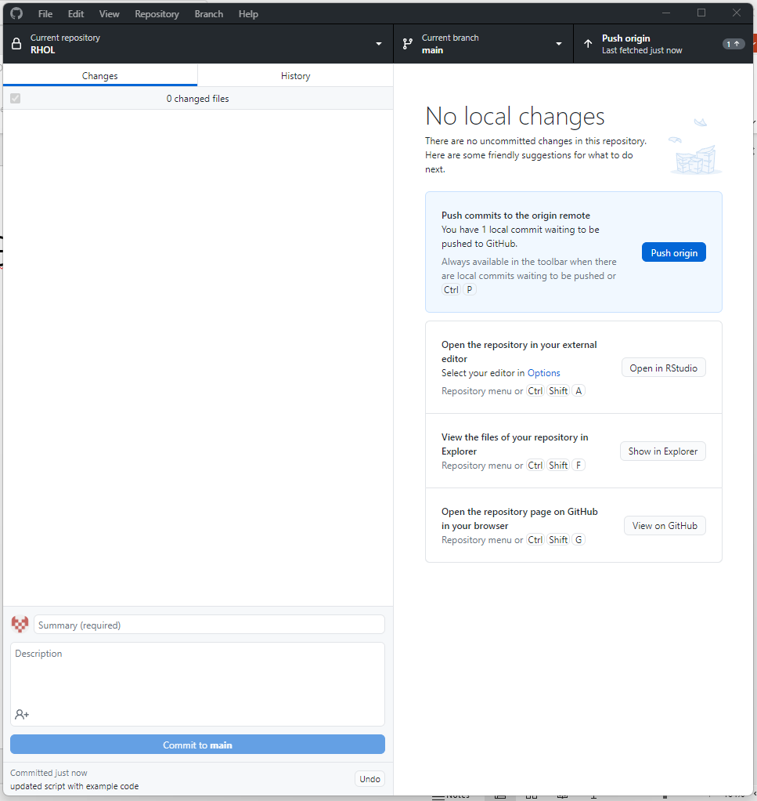
Github Connectivity – Github Desktop

Slide 8
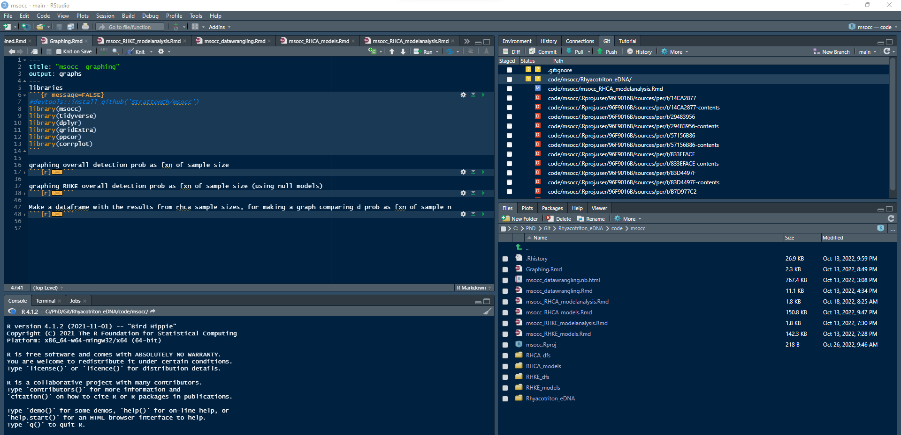
Github Connectivity – R Studio

Slide 9
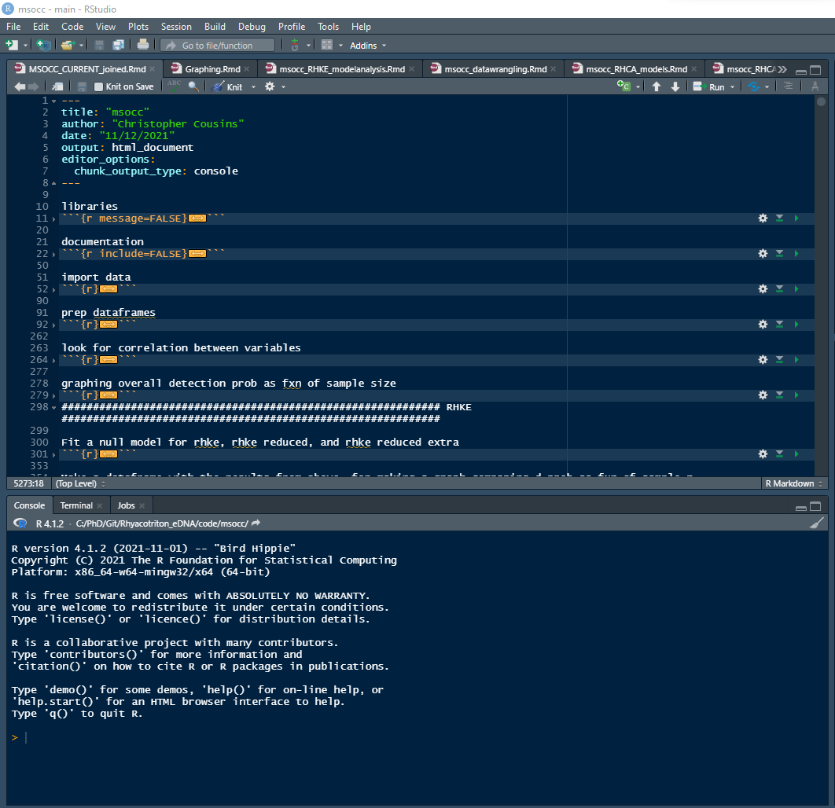
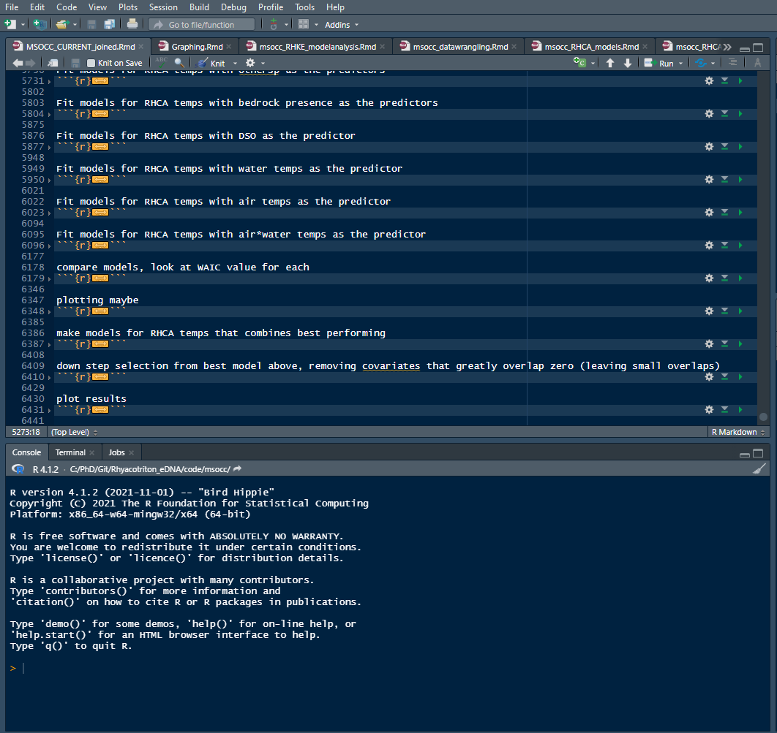
Github and R – Pre-modularization

Slide 10
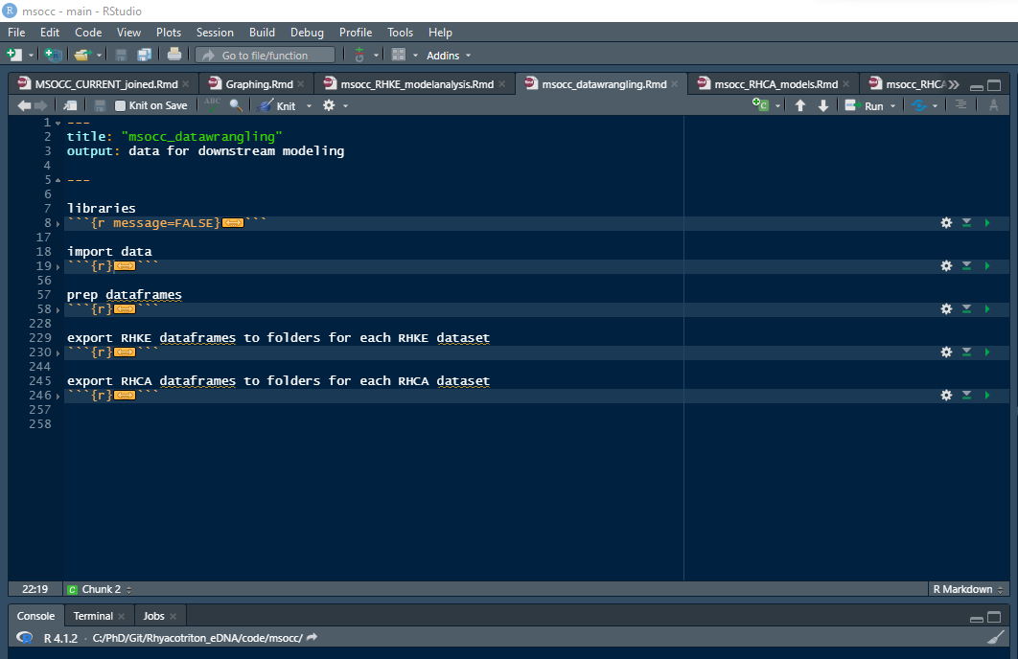
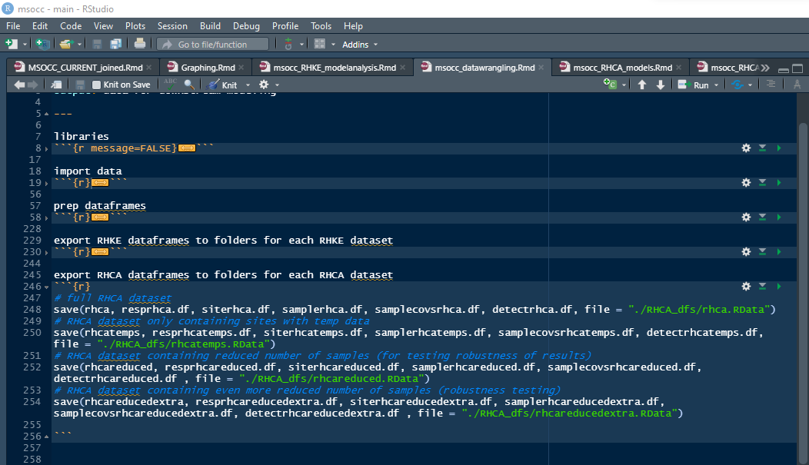
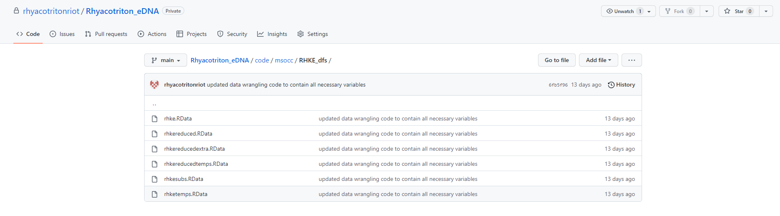
Github and R – Post-modularization

Slide 11
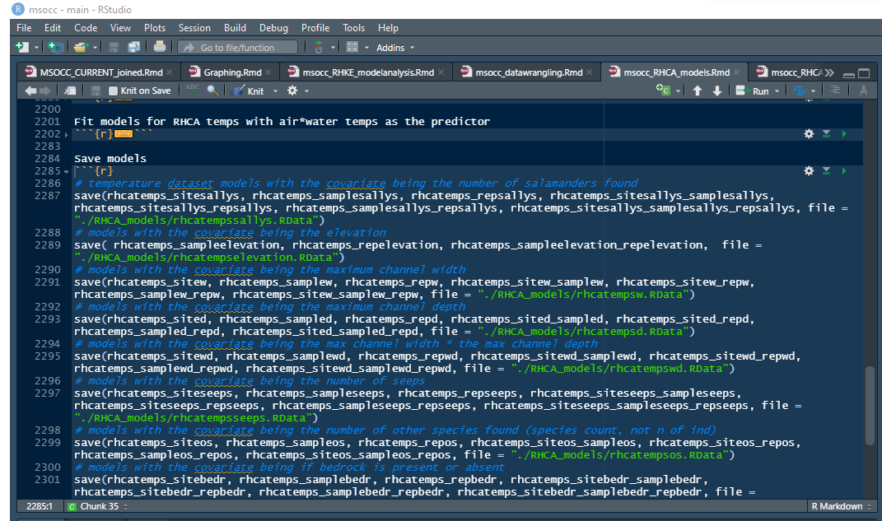
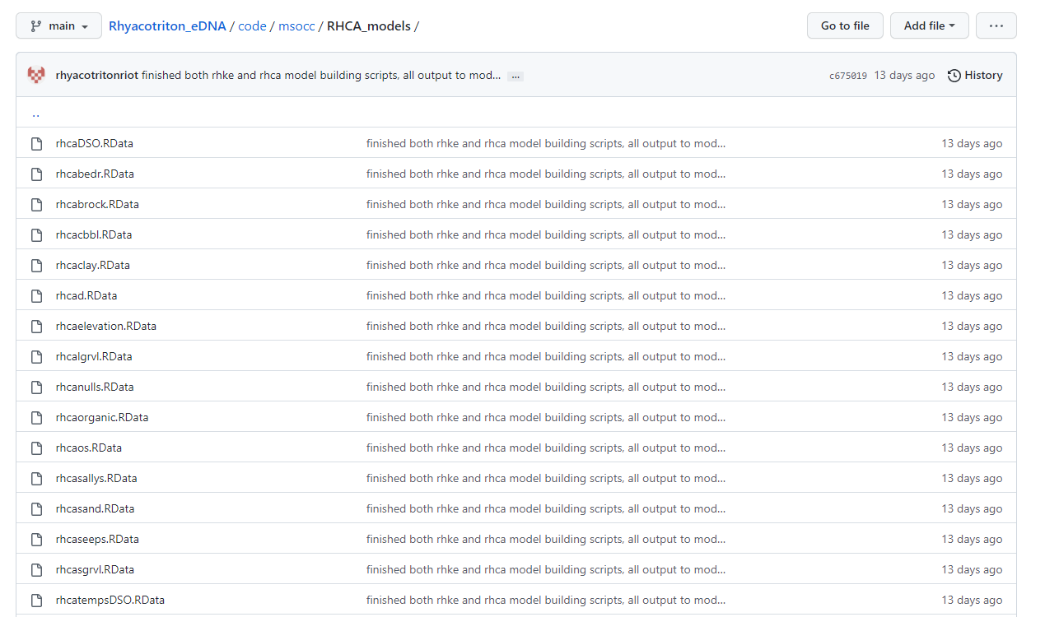
Github and R – Post-modularization

Slide 12
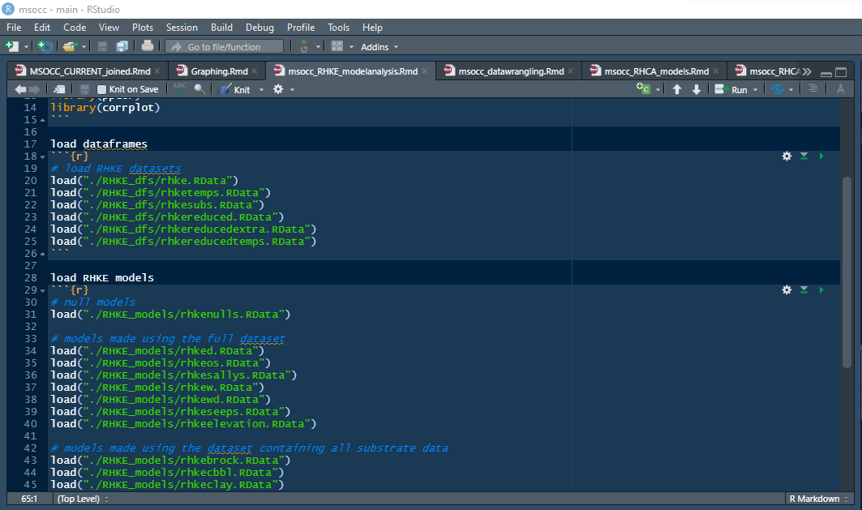
Github and R – Post-modularization

Slide 13
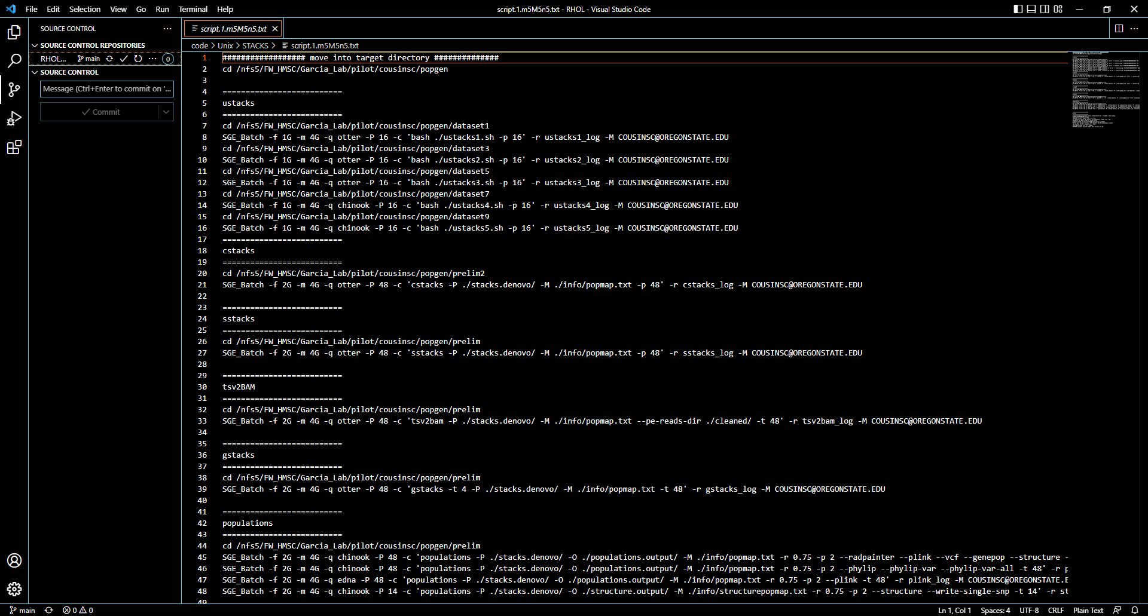
Github Connectivity – Visual Studio Code

Slide 14
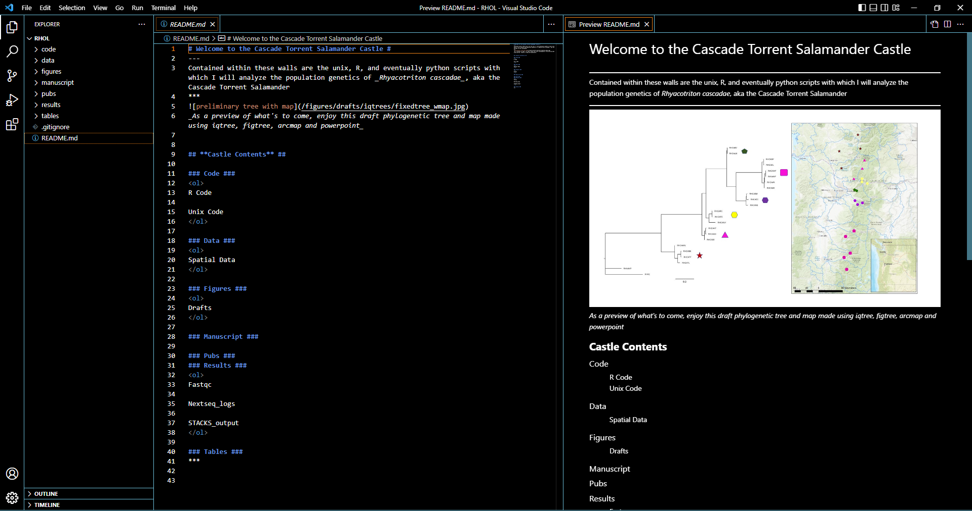
Github Connectivity – Visual Studio Code

